Slide 1
Domestic Abuse

Slide 2
What is Domestic Abuse?
Any incident or pattern of incidents of controlling, coercive or threatening behaviour, violence or abuse between those aged 16 or over who are or have been intimate partners or family members regardless of gender or sexuality. This can encompass but is not limited to the following types of abuse:
psychological
physical
sexual
financial
emotional
This definition, which is not a legal definition, includes so called 'honour’ based violence, female genital mutilation (FGM) and forced marriage, and is clear that victims are not confined to one gender or ethnic group.

Slide 3
Local Picture
2016/2017
DV Incidents 3102
Referrals to MARAC 352
Referrals to Refuge 157 of which 30 were admitted
Referrals to Outreach 227
Notes:
Children were present at 56% of DV incidents reported to police
Seasonal peaks in summer and Christmas period
A general rise of 6% reported incidents and another rise forecast for 2014/2015
Explain MARAC how it operates, referral process, nature of high risk, etc
Average cost of each MARAC case is £21k
Refuge offers 20 safe bed spaces.
Explain reasons for referrals being denied.
CRI Service currently commissioned by local authority. Due to a massive cut in budget the LA can only commission services with stat responsibility. Explain the gap in provision expected.

Slide 4
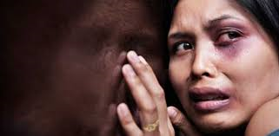
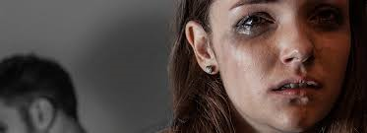
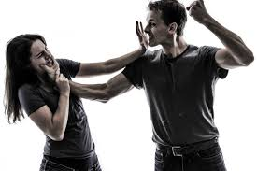
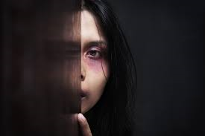
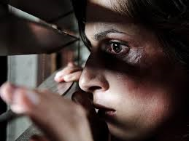
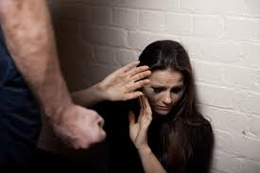
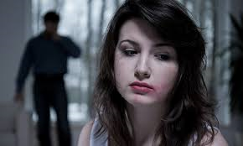
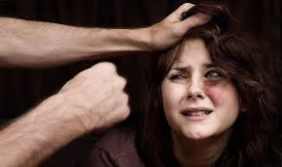
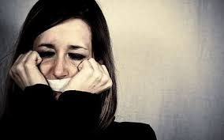
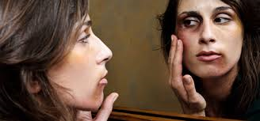
Who is a victim?

Slide 5
Marie
Marie and her partner met sometime in 2005 and they were married in July 2007.
Marie was a Staff Nurse at a local hospital and had been employed there for a number of years.
Her colleagues at the hospital said that Marie was extremely well liked by staff and by patients.
She had a good sense of humour and was described as being very loyal, a hard worker who was always punctual and someone who was prepared to cover for any staff absences.
Notes:
Marie was murdered by her bigamist husband in 2014

Slide 6
Michelle
26 Years old, loving mother of 2 young children
Michelle works for a building society and manages her own home as her partner is a serving officer in the British Army based in Plymouth.
She is a bright young woman and works hard.
Notes:
Michelle was murdered by her partner in 2017

Slide 7
Mike
Moved to Dorset to care for his elderly father who has dementia.
He is divorced and has 3 sons from his previous marriage.
He describes his marriage as “difficult” and that “drunkenness and violence were the norm”. He feels that both he and his ex-wife “mishandled” their role as parents.
Mike enjoys a drink.
Notes:
Mike was murdered by his son in 2011

Slide 8
Who is a victim?
Notes:
These images are from a google search of domestic abuse victims. The images we often see do not fit with reality as anyone can become a victim of domestic abuse. Mothers, fathers, couples, grandparents, children from any nationality, from any social background.

Slide 9
Why do people perpetrate?
Michael Johnson’s Theory:
Intimate Terrorism
Situational Couple Violence

Slide 10
Intimate Terrorism
Involves patterns of controlling and coercive behaviour
Perpetrators use violent and non violent tactics to gain complete control over the victim
The purpose of the abuse is to gain power and control
Alcohol is NOT a major factor
More traditional in their gender identity
Emotionally dependent on partner – attachment issues, fear of loss of their partner, can exert complete control in order to keep them.
High score on symptoms of borderline personality.

Slide 11
Situational Couple Abuse
Violence occurs because the couples have conflict which turns into arguments which can result in violence
Occurs more in poorer families
Substance misuse, unable to emotionally regulate, communication issues
Alcohol plays a factor which leads to escalation of violence
Frequent arguments can result in violence
Both partners can be violent

Slide 12
Situational Couple Violence
Childhood experiences of domestic abuse
Other childhood trauma
No experience of healthy relationships
Lack of emotional regulation
Poor problem solving
Attitudes that support domestic abuse
Link to alcohol and substance misuse
Poor attachment
Function of control to prevent insecurity
Life stress
Relationship breakdown
Peer group that support attitudes
Jealousy

Slide 13
Domestic Violence outside of couple relationships
As stated earlier, domestic violence is not confined to couples, or former partners.
There is an increase in awareness of domestic abuse perpetrated by adult children or grandchildren.
People who work with those who receive care at home, or in a residential setting, can be well placed to recognise domestic abuse, whether that is between couples or wider family relationships.

Slide 14
Conditioning
Dependency
Entrapment

Slide 15
Fear
What is fear ?
Notes:
So the subject of this lecture is to consider the question ‘Are you afraid of someone?’ lets first talk about fear because its a complicated concept. When we think of fear we might think of someone cowering or crying, or defending themselves. We have an understanding that people would want to remove themselves from situations which make them frightened. After all why would you do something which frightens you if you were really scared?
If someone stays in a relationship with someone, and doesn’t leave that person, they can’t be really scared can they? And you may think that murder and serious harm are things associated with people who have ‘killer’ tattooed across their forehead and we can spot them?
Murder is what happens in Midsomer. Unfortunately, for women – the most dangerous person for you, statistically, is someone you know. Everyone tells you to never walk home alone, and always keep your wits about you. That may be good advice, but the biggest danger is presented when you reach your front door.
So lets talk about two types of fear first to kick things off.

Slide 16
Immediate fear
Notes:
Lets think about immediate fear.
If I were to approach you and threaten you, put my fist in your face, you may be fearful that I was going to hurt you. Now if I was bigger than you or had a weapon you might respond with the classic symptoms of someone really scared. Shaking, sweating, running, attacking, a head full of the possibilities. This is immediate fear.
Now if I back off, apologise, put my weapon down, get stopped in some way, your immediate fear will turn into something else. Relief probably. But once the threat is gone things can de-escalate physically for you.
People may call the police when they are experiencing immediate fear. The police can remove the fear and everything goes back to normal.

Slide 17
Chronic fear
DREAD
Notes:
So lets think about another form of fear. Chronic fear.
This is a form of fear which builds up over time as a result of a continuous threat. The threat may be high level or low level. I think its what we could call dread. We all know that awful feeling in your stomach which won’t go away. Some people are afraid of interviews or public speaking for example, and they will feel anxious for days before the dreaded time.
Chronic fear is very similar. It’s a constant and unrelenting anxiety that something could happen which you don’t want to happen. If you put this in the context of someone you are afraid of, and you are maybe living with that person, you might see that the constant possibility of negative moods and reactions could be seriously stressful over time. The constant drip drip of fear of consequences starts to become normalised, you start to manage the danger to yourself. Just as you manage the danger to immediate fear. But you don’t call the police for chronic fear. Its something to be managed on a day to day basis. It doesn’t seem serious enough.

Slide 18
Fear of someone
Walking on eggshells
Avoiding the consequences of upsetting someone
Threats to your safety or that of someone else
Coerced compliance
Notes:
Remember what its like at Christmas – there’s always some relative you have to tread on eggshells around. We do it though because we don’t want upset or arguments.
However, It could be that you experienced a violent or menacing threatening outburst from the person who frightens you. You may have been assaulted, pinned down, strangled, a pet hurt, a child threatened. You won’t want this to happen again so you start to learn how to stop it happening again.
In this way constant violence is not necessary. The control has begun. Your compliance has been coerced through fear of consequences.
Sometimes the fear starts so slowly you hardly notice it, but one day you realise you are doing something, that’s not in your own best interests, because you’re frightened not to.
It can start by a friendly manipulation, then moaning, then sulking, then arguing, then threatening, maybe violence or the threat of violence. You comply because its easier to go along with it.

Slide 19
Coercive Control
domestic abuse/violence
stalking
psychological abuse/abuse of process
Notes:
I would suggest that in thinking about coercive control we think of that concept as the umbrella characteristic which links many forms of interpersonal abuse.
Coercive control is the umbrella concept.

Slide 20
Methods of Coercive Control
Violence
Threats of violence, threats to kill, threats to commit suicide
Threats to family, friends, children, pets
Temper tantrums, sulking,
Removing resources
Crying, begging, apologising
Stalking
Intimidation
Notes:
Particularly in domiciliary care or visiting

Slide 22
Case Study: Oscar Pistorius
Reeva Steenkamp sent messages to Pistorius saying she was afraid of him
A previous girlfriend said she was scared of him and would hide his gun
Excessively jealous
Would call parents 10 times a day to check where she was
700 calls in one month checking her whereabouts
Would lock the doors to make sure she couldn’t go out

Slide 23
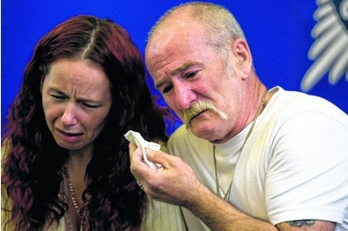
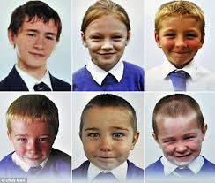
Case study: Mick Philpott

Slide 24
Domestic Violence in older people
Assumptions about age can mean that when older people are seen to be injured, unhappy, depressed or have other difficulties, these are presumed to be the result of health or social care needs.
This can mean that signs of domestic abuse are missed.
Professionals should take great care to assess older people, along with other groups, in a person-centred way, asking open questions and enabling the person to identify their needs.
It is important to avoid judgements based on stereotypical expectations of the needs of older people and the services they require.

Slide 25
Indicators
Physical injuries
Changes in behaviour
Repeated missed appointments
Fear of partner/family member’s responses to things they do
Partner/family member monitoring them closely e.g. attending appointments, texting or calling all the time
Partner’s jealousy
Begins/increases alcohol or drug use
Stops spending time with peers (other than partner)
Unable to access money

Slide 26
Who Can Help?
Dorset Outreach
0800 032 5204
Victim Support
0300 3030 163
Dorset Police
999 or 101
Bournemouth Outreach
01202 547 755
Poole Outreach
01202 710 777

Slide 27
Questions

