Slide 1
Event for Independent Care Providers, Community and Voluntary Groups
Barrie Crook Independent Chair
Claire Hughes Business Manager
Tuesday 11th February 2020

Slide 2

Our Mission
The Board exists to protect adults at risk from abuse, significant harm or neglect.
We will achieve this through strategic leadership and collective accountability

Slide 3

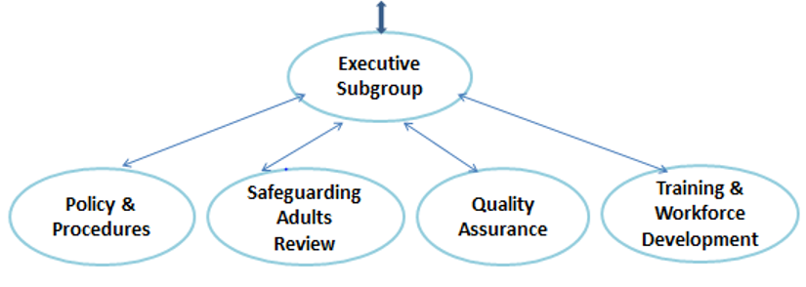
What do we do?
The Care Act 2014 S.43 states that every local authority must have a Safeguarding Adults Board. The Board must assure itself that everyone is working together to keep adults safe in its area.
The Board exists to protect adults at risk from abuse, significant harm or neglect.
Core duties
SABs have three core duties. They must:
Develop and publish a strategic plan setting out how they will meet their objectives and how their member and partner agencies will contribute.
Publish an annual report detailing how effective their work has been.
Commission safeguarding adults reviews (SARs) for any cases which meet the criteria for these.
All safeguarding activity should have at its core these six principles:
Empowerment, Prevention, Proportionality, Protection, Partnership, Accountability.
Notes:
Board meets 4 times per year, same as subgroups with the exception of SAR group which is more frequent.

Slide 4
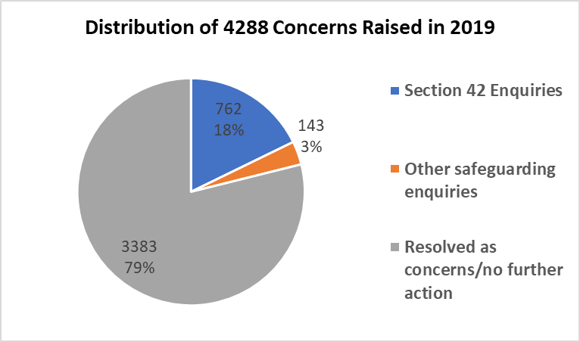
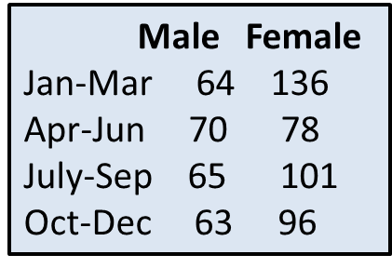
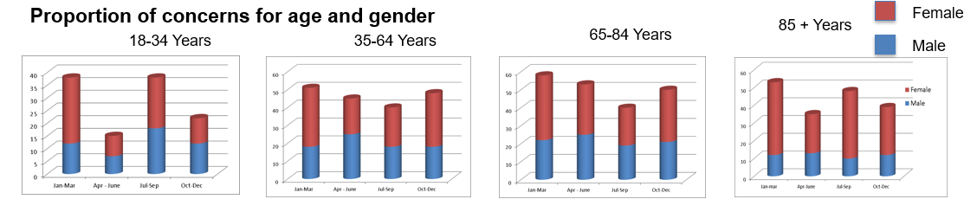
Safeguarding Activity Across Bournemouth, Christchurch* and Poole in 2019
Section 42
Enquiries
by gender
BCP Council received
4288 concerns
in 2019, leading to 762 Section 42 Enquiries and 143 other Safeguarding Enquiries
*Christchurch data from
1st April 2019

Slide 5

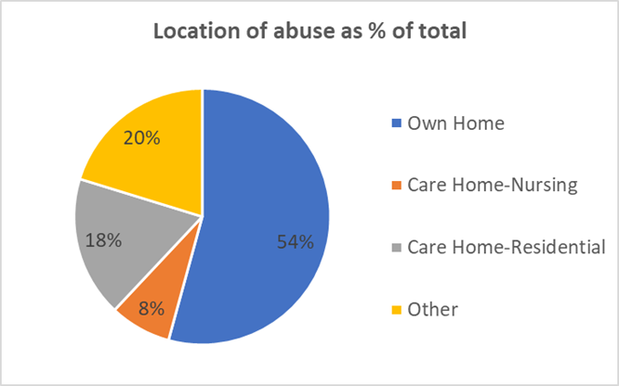
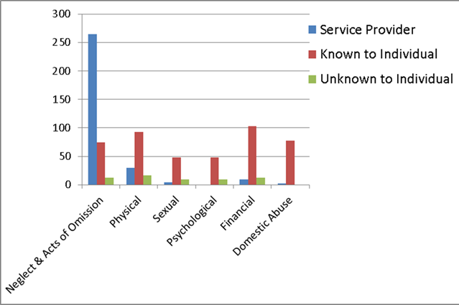
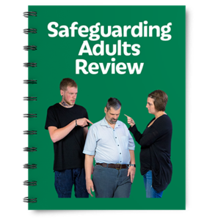
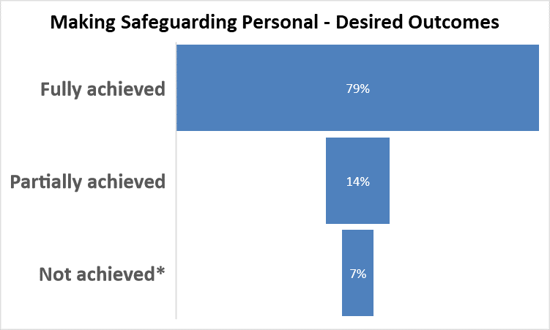
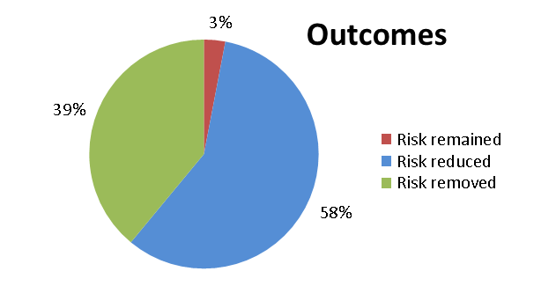
Safeguarding Activity Across Bournemouth, Christchurch* and Poole in 2019
Type of abuse
*Christchurch data from
1st April 2019
There was one
Safeguarding
Adults Review in 2019 in the former Borough of Poole which is being progressed as a joint SAR/DHR and MAPPA review
In 65% of cases individuals were asked for their desired outcomes.
*Some outcomes not
achieved
as they may not have
been possible, or safe

Slide 6
Some Emerging Concerns
use of social media among service users
mate crime
criminal exploitation among young people in transition
safeguarding and the homeless

Slide 7
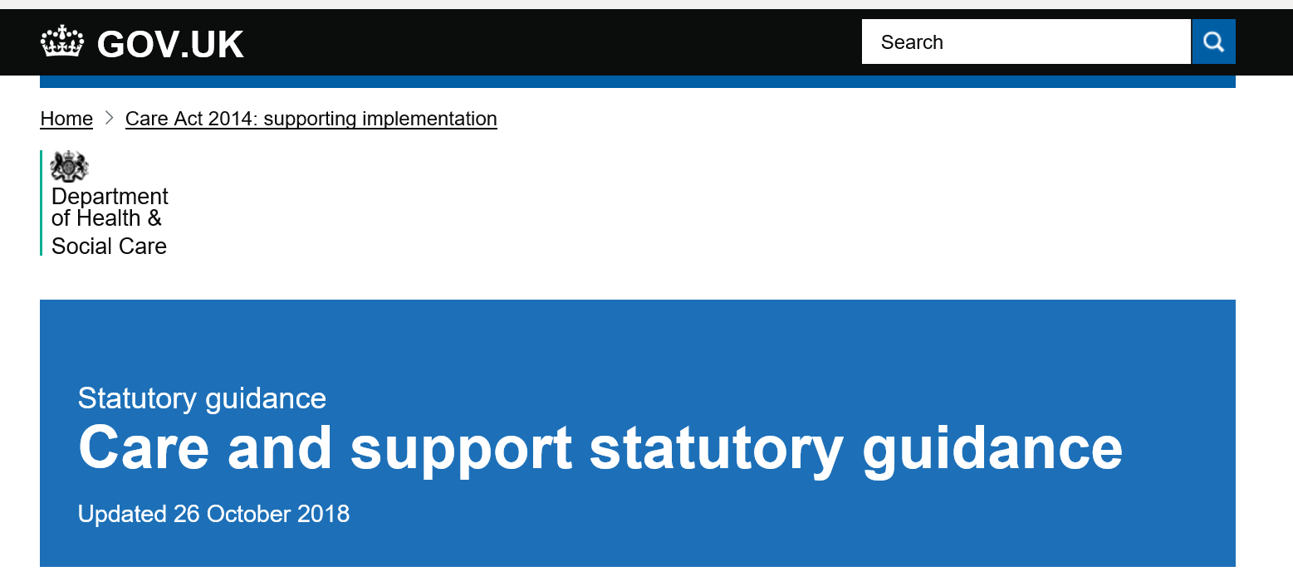
Self Neglect - Care Act (2014) Statutory guidance 14.17
“This covers a wide range of behaviour neglecting to care for one’s personal hygiene, health or surroundings and includes behaviour such as hoarding. It should be noted that self-neglect may not prompt a section 42 enquiry. An assessment should be made on a case by case basis. A decision on whether a response is required under safeguarding will depend on the adult’s ability to protect themselves by controlling their own behaviour. There may come a point when they are no longer able to do this, without external support.”

Slide 8
Neglect of self-care
Neglect of the domestic environment
Personal hygiene
Nutrition/hydration
Health
Hoarding: (“persistent difficulty discarding or parting with possessions, regardless of value” DSM V )
Squalor
Infestation
To such an extent as to endanger health, safety and/or wellbeing
Refusal of services that would mitigate risk of harm
“Self-neglect: this covers a wide range of behaviour neglecting to care for one’s personal hygiene, health or surroundings and includes behaviour such as hoarding” (DHSC 2018)

Slide 9
What’s going on for the individual?
Complex interplay of physical, mental, social, personal and environmental factors, and of (un)willingness and (in)ability
Need for understanding the meaning of self-neglect in the context of each individual’s life experience
No single overarching explanatory model

Slide 10

Neglect & Acts of Omission
(Statutory guidance 14.7)
ignoring medical
emotional or physical care needs;
failure to provide access to appropriate health, care and support or educational services
the withholding of the necessities of life, such as medication, adequate nutrition and heating.

Slide 11
Neglect & Acts of Omission – new sub categories 19/20 for Section 42 Enquiries
Neglect & Acts of Omission – new sub categories for Section 42 Enquiries for 19/20
Carer not following care plan/ professional advice
Carer Stress
Provider not following care plan
Medication error
Missed visit/s
Pressure Sores
Other

Slide 12
record and store all information about risk
ensure staff know where to find information and read protection plans
train staff to recognise risk and be confident in enabling clients to disclose
share information with partner agencies regularly
recognise that levels of risk can fluctuate and keep safeguarding plans under review
escalate
concerns
Learning
for
providers

Slide 13

Any Questions?

Slide 14

From DoLS to the
Liberty Protection Safeguards
BCP Safeguarding Adults Board
Provider Event
Esther Donald MCA Operational Manager
and Sarah Webb, Head of Statutory Services
BCP Council

Slide 15
DoLS to LPS presentation
Background to the change in legislation
Over view of the differences between DoLS and Liberty Protection Safeguards (LPS)
Information about what happens next

Slide 16
Background to the changes
DoLS legislation introduced in 2009
In 2014, Supreme Court in Cheshire West judgment was published
Introduced what is known as the ‘acid test’
Lowered the threshold for who is deemed to be deprived of liberty

Slide 17
Background to the changes
Criteria remains the same – a person who lacks capacity to consent to the arrangements for their care and treatment is subject to ‘continuous supervision and control and not free to leave’ (known as the Acid test).
LPS authorisation should be in place before arrangements amounting to dol happen, unless ‘emergency’

Slide 18
MENTAL CAPACITY AMENDMENT ACT 2019
Legislation to replace DoLS with Liberty Protection Safeguards (LPS) received Royal Assent on 16th May 2019.
Expected implementation in 2020.
DoLS may run alongside LPS for 1 year to ‘ease’ the transition of existing case
Limited information available of how this will look in practice.
Regulations and Code of Practice will answer a lot of questions and expected to be published in draft February 2020.

Slide 19
Age
DOLS | LPS | DETAIL
18+ | 16+ | ?numbers

Slide 20
Environment
DOLS | LPS | DETAIL
Care Homes and hospitals | Anywhere | Can be used in any setting e.g. supported living, and domestic settings, residential schools ? Numbers?

Slide 21
Authorising body
DOLS | LPS | DETAIL
‘Supervisory Body’ – Local Authorities | ‘Responsible Body’ – Commissioner or funder of care | Hospital Manager for NHS hospitals CCG for mainly NHS CHC arrangements LA for everyone else, including private hospitals

Slide 22
ASSESSORS
DOLS | LPS | DETAIL
Minimum of two assessors: Specially trained Doctor Best Interest Assessor (BIA) | Majority of assessments can be undertaken by any member of staff of NHS Trust, CCG, Health Board or LA. Care homes to choose assessors but mustn’t have a prescribed connection to the home. | This will follow in guidance, but mental capacity and mental disorder assessments must be completed by a registered professional.

Slide 23
ASSESSORS
DOLS | LPS | DETAIL
Best Interest Assessor | Approved Mental Capacity Professional (AMCP) | Likely to be conversion from BIA LA must ensure sufficient AMCPs available (not employ) Must be involved in certain circumstances (objection) and can be involved in others Reviews the information, and authorises. May consult with person and others

Slide 24
ASSESSMENTS / EVIDENCE
DOLS | LPS | DETAIL
Old assessments can be reused in certain circumstances but Best Interest Assessment usually undertaken every time | Some assessments /evidence can be reused if still applicable - e.g. mental disorder, MCA Consultation is required Must complete ‘Necessary and Proportionate’ assessment | Less bureaucratic especially for people with established diagnosis and stable conditions / care arrangements

Slide 25
MHA/LPS INTERFACE
DOLS | LPS | DETAIL
Eligibility assessment undertaken by Dr or AMHP – should the person’s dol be authorised under the Mental Health Act instead. | ‘Excluded arrangement assessment’. | This is a complex area of law, and no official assessor identified under LPS as yet.

Slide 26
PRE-AUTHORISATION REVIEW
DOLS | LPS | DETAIL
6 assessments completed | Draft Authorisation record must be produced by someone. | Care Home manager? Social Worker / CHC staff? Ward staff? Supported Living Provider?

Slide 27
AUTHORISATION RECORD
DOLS | LPS | DETAIL
Scrutiny after 6 assessments received, by Adult Social Care manager in Local Authority. (Local arrangement as to what level). | Reviewed by person in Responsible Body (RB). Must not be involved in day to day care or treatment of person. | Can be ‘desk top’ exercise unless referred to AMCP. Not involved in any aspect of arrangements.

Slide 28
AMCP INVOLVEMENT
DOLS | LPS | DETAIL
Similar to when we would prioritise referral as ‘High’ | Must be referred to an AMCP if person objecting, in Private Hospital, or at discretion of Responsible Body | Completes pre authorisation review. Can meet person and consult others and authorises. (Combination of BIA and scrutineer role)

Slide 29
DURATION
DOLS | LPS | DETAIL
Up to 1 year | - Up to 1 year initially - Renewed up to 1 year - Renewed up to 3 years | At discretion of RB Paper based if nothing has changed / is likely to change and consultation has taken place

Slide 30
REVIEWS
DOLS | LPS | DETAIL
If/when required (change of circumstances/change of rep, if requested etc) | Authorisations MUST have ‘regular programme’ of reviews. | ? Who undertakes. Could it be part of Care Act work.

Slide 31
AUTHORISATION RECORD
DOLS | LPS | DETAIL
Summary record of assessments and scrutiny to say evidence has been supplied | Time it begins and ends Programme of reviews Details of representation and support May include other information

Slide 32
IMCA
DOLS | LPS | DETAIL
During assessment process if unbefriended, and to support unpaid Relevant Person’s Representative (RPR) and person | If no ‘Appropriate Person’ available, unless it is considered it would not be in the person’s best interests. Appointed by Responsible Body (RB). | Right to advocacy is less than under DoLS.

Slide 33
APPEALS
DOLS | LPS | DETAIL
Court of Protection | Same | Responsible Body taken to Court of Protection (NHS Trust, LA, CCG, Health Board)

Slide 34
APPROPRIATE PERSON
DOLS | LPS | DETAIL
Relevant Person’s Representative (RPR) - Statutory duty to maintain contact with person | Appropriate Person – no statutory duty to maintain contact | Can’t be engaged in providing care or treatment, or professionally involved.

Slide 35
RIGHTS
DOLS | LPS | DETAIL
Duty to inform of DoLS authorisation | Duty to inform | Without delay – within 72 hours and if not, record why not.

Slide 36

Plan for coming months
Information updates and training
Consultation and getting involved

Slide 37
Safe Relationships
Rachel Young
Domestic and Sexual Violence Co-ordinator

Slide 38
Legal/illegal Quiz
Two 32 year olds sexually touching at a party. One has had a lot to drink and has been confused and finding it difficult to stay awake. The other doesn’t drink.

Slide 39
Illegal
The Sexual Offences Act 2003 defines ‘consent’ as someone agreeing by choice, and having the freedom and capacity to make that choice. In this case, he has continued touching her without consent, which is sexual assault.

Slide 40
Q2
A group of men go to a strip club together, and two of them pay for a lap dance

Slide 41
Legal
This is not an offence, unless the person/s who provide the sexual service (i.e. stripping, lap-dancing) has been forced, threatened or coerced.

Slide 42
Q3
A 19 year old female youth worker having a consensual sexual relationship with her 16 year old boyfriend, who she met at the youth club

Slide 43
Illegal
Specific roles include:
teachers
social workers
doctors
foster carers
police officers
Specific settings include:
educational institutions
hospitals
foster homes
residential care homes
young offenders institutions
independent clinics

Slide 44
Q4
A 56 year old man buys his friend double-shots of vodka when she thinks she’s drinking singles, with the intent of getting her too drunk to be able to refuse sex

Slide 45
ILLEGAL
Intentionally administering a substance with the intent of overpowering someone to engage in sexual activity is an offence under the Sexual Offences Act 2003.

Slide 46
Q5
A man pays his drug debt by allowing the dealer to have sex with his girlfriend

Slide 47
ILLEGAL
It is an offence under the Sexual Offences Act 2003 to intentionally cause or incite another person to become a prostitute in any part of the world.

Slide 48
Q6
17 year old male and 21 year old male having consensual sex

Slide 49
Legal

Slide 50
DHR/SAR
Harry

Slide 51
Harry
22 years old
“Moderate” Learning disability
Harry felt limited by his learning disability
Vulnerable to financial abuse
Assessed as having capacity in relationships

Slide 52
Harry
23 Hours of additional support per week in a 24 hour supported accommodation
Lonely and bored
Wanted love and affection

Slide 53
Learning
Harry was susceptible to manipulation and coercion as he was a vulnerable young adult.
Multiple safeguarding processes
Fluctuating capacity
The BIG picture
Social media

Slide 54
Supporting vulnerable adults
ATTACHMENT

Slide 55
Supporting Relationships
Amy Hurst
Principal Social Worker (Adults)

Slide 56

Relationships are important
Relationships are a right

Slide 57
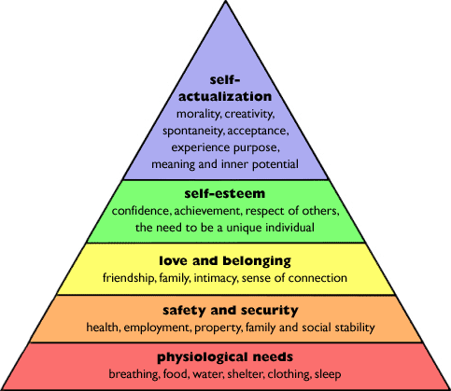
Maslow’s Hierarchy of Needs
A. H. Maslow (1943)
Originally Published in Psychological Review, 50, 370-396.
Notes:
What are relationship? Who are in our relatinships? Friendship, family, intimacy, professional realtionships, Maslow hierarchy of needs - Belongingness – includes love, friendship, intimacy, family, etc
How do we value and support the relationships for people we are supporting?
We want people to thrive right? Local Authority supporting fulfilled lives
How do we support people to maintain relationships when someone moves into care?

Slide 58

Who decides?

Slide 59

Positive and informed personal relationships
https://www.skillsforcare.org.uk/Documents/Topics/Learning-disability/Supporting-meaningful-relationships.pdf

Slide 60
DISCUSSION:
What are our challenges and opportunities when supporting vulnerable adults to identify and maintain meaningful relationships?

Slide 61
Thank You
Rachel.young@bcpcouncil.gov.uk
Amy.hurst@bcpcouncil.gov.uk

Slide 62

1. Liberty Protection Safeguards.
How can this knowledge be used within your organisations?
What other information/support would you find useful and in what format?
2. Relationships
What are our challenges and opportunities when supporting vulnerable adults to identify and maintain meaningful relationships?
3. Safeguarding Adults Board’s strategic objectives are the following:
• Domestic Abuse
• Neglect and Self –Neglect
• Exploitation
Please share your thoughts on how this links with your work and priorities.

Slide 63
Event for Independent Care Providers, Community and Voluntary Groups
Barrie Crook Independent Chair
Claire Hughes Business Manager
Tuesday 11th February 2020

Slide 64
Some of your comments
The LPS information is useful but until the code is approved we won’t know how complicated the changes are

Slide 65
Some of your comments
The information on relationships is
There are XX people that I can think of who might be vulnerable to the wrong kind of relationships
I didn’t realise that XXXXX was illegal

Slide 66
Some of your comments
The LPS information is useful but until the code is approved we won’t know how complicated the changes are

